Slide 1

Guidelines
Kindly use the given template for submitting your project (Make a copy of the template)
One team is only required to submit one project.
The ideal size of the presentation should not be more than 10 slides.
You are welcome to add as many POCs and design concepts to support your project.
The project should be feasible and the team members should be capable enough, to come up with the prototype of the same idea, if required.
Projects using Google developer technologies like Gemini APIs & building projects on IDX platform will earn additional points.
In case of queries, kindly reach out to us at solutionchallengesupport@hack2skill.com

Slide 2
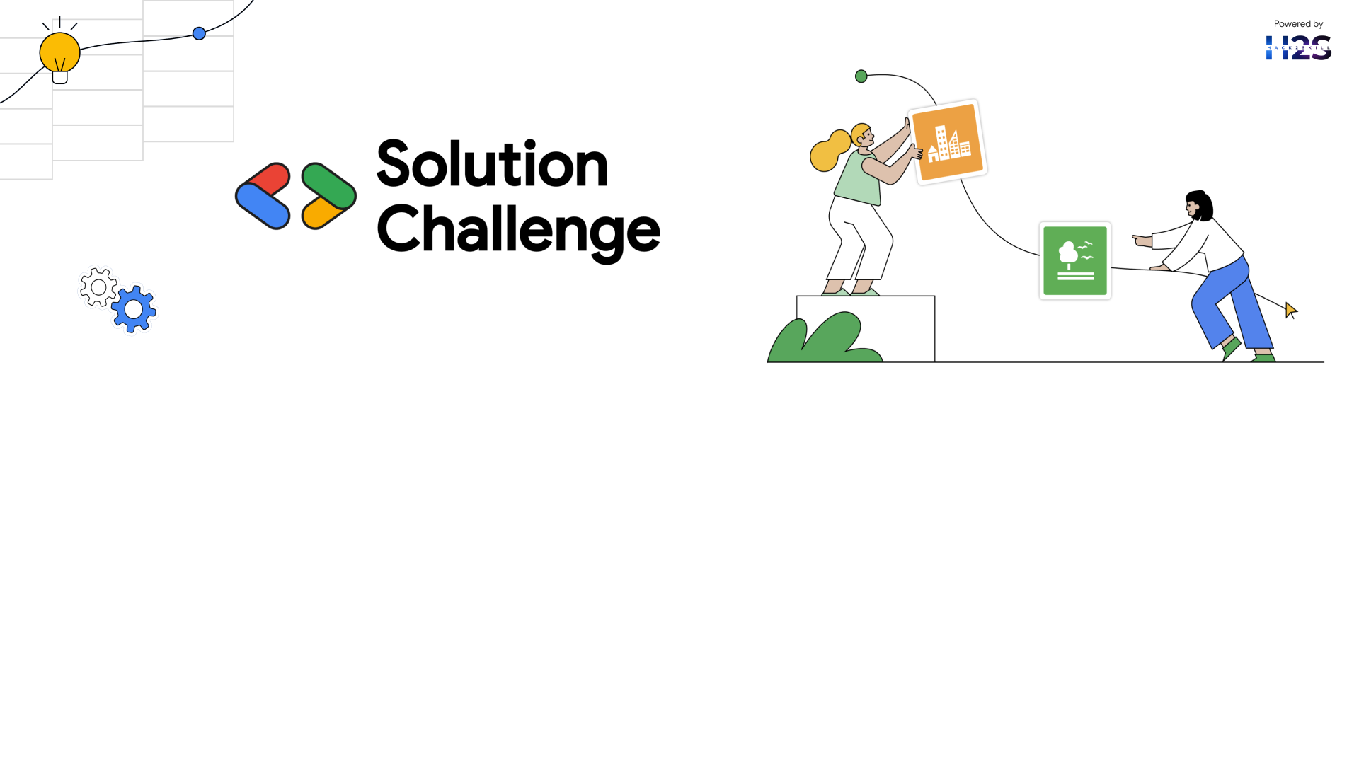
Team Details
Team name: Logic Loom
Team leader name: Anushree P
Problem Statement: Empowering Small And Marginal Farmers with AI Driven Agricultural Solutions.

Slide 3
Brief about your solution
✅ Satellite-Based Agricultural Monitoring
✅ AI-Powered Alerts & Crop Recommendations
✅ Government Loan Assistance
✅ Crop Disease Detection & Treatment
✅ Global Warming Detection & Afforestation Alerts
✅ User-Friendly Web & Mobile App

Slide 4
Opportunities
a. How Different Is It from Existing Ideas?
✅ Integration of AI, IoT, and Satellite Data: Unlike most agricultural platforms that focus on either AI-based crop recommendations or satellite monitoring, our solution combines AI, IoT sensors, and satellite imagery for a holistic farming approach.
✅ Global Warming Detection & Afforestation Alerts: Our platform not only helps farmers but also contributes to climate resilience by identifying global warming-affected areas and notifying agencies for tree plantation initiatives.
✅ Automated Government Loan Assistance: Many platforms provide market insights, but our solution helps farmers access financial aid quickly, reducing risks from crop failures.
b. How Will It Solve the Problem?
✅ Real-Time Insights for Farmers: By monitoring soil health, crop growth, and weather conditions, we help farmers make informed decisions to improve yield and productivity.
✅ Preventing Crop Losses: AI-powered disease detection and pest alerts help reduce crop damage, ensuring sustainable farming.
✅ Financial Stability for Farmers: Easy loan assistance and eligibility verification support farmers in avoiding debt traps and mitigating risks from crop failures.
✅ Climate-Smart Farming: By detecting climate change-affected areas and promoting afforestation, our solution supports long-term agricultural sustainability.

Slide 5
c. USP (Unique Selling Proposition) of the Proposed Solution ✅ End-to-End AI-Driven Agriculture Solution: A one-stop platform integrating AI, IoT, and satellite data for monitoring, recommendation, and financial assistance. ✅ Smart Global Warming Detection & Tree Plantation Alerts: Our system proactively fights climate change while supporting sustainable farming. ✅ User-Friendly Web & Mobile App: Designed with React.js, Node.js, and Firebase, making it easily accessible to farmers. ✅ Scalability & Government Collaboration: The system is scalable and can be integrated with government policies to support millions of farmers nationwide.

Slide 6
List of features offered by the solution
✅ Satellite-Based Soil & Crop Monitoring – Tracks soil moisture, temperature, and crop health in real-time.
✅ AI-Powered Crop & Fertilizer Recommendations – Suggests the best crops and fertilizers based on soil quality and weather conditions.
✅ Automated Disease & Pest Detection – Uses AI & computer vision to detect crop diseases early and provide treatment recommendations.
✅ Weather Forecast & Alerts – Provides real-time weather updates and extreme weather alerts for better planning.
✅ Government Loan Assistance – AI-powered system helps farmers check loan eligibility and apply for financial aid easily.
✅ Global Warming Detection & Afforestation Alerts – Identifies climate-affected areas and notifies government agencies for tree plantations.
✅ IoT-Based Soil Health Monitoring – Uses sensors to measure soil pH, moisture, and nutrient levels, ensuring better crop management.
✅ Mobile & Web App for Farmers – Easy-to-use platform for real-time insights, alerts, and recommendations.
✅ Multi-Language AI Chatbot Support – Assists farmers in regional languages for better accessibility.
✅ Market Price & Demand Analysis – Helps farmers choose the best crops based on market trends, increasing profitability.

Slide 7
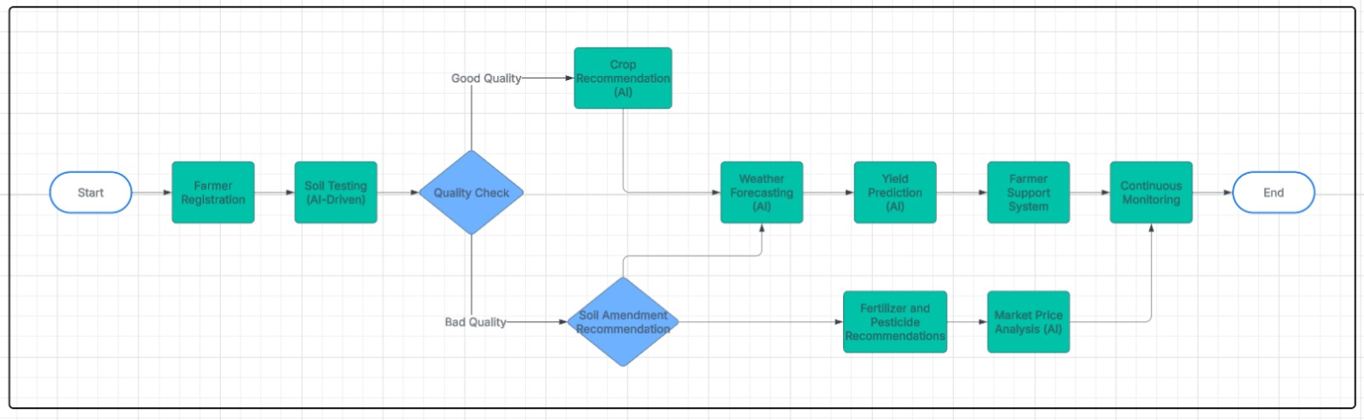
Process flow diagram or Use-case diagram

Slide 8
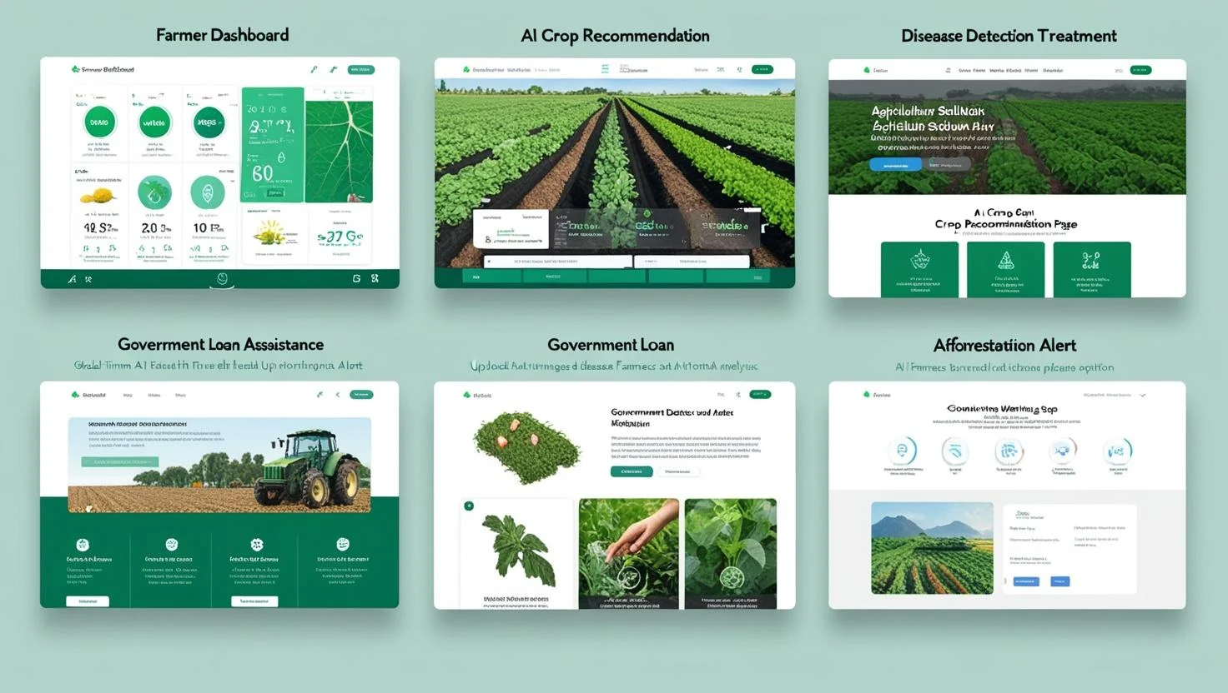
Wireframes/Mock diagrams of the proposed solution (optional)

Slide 9
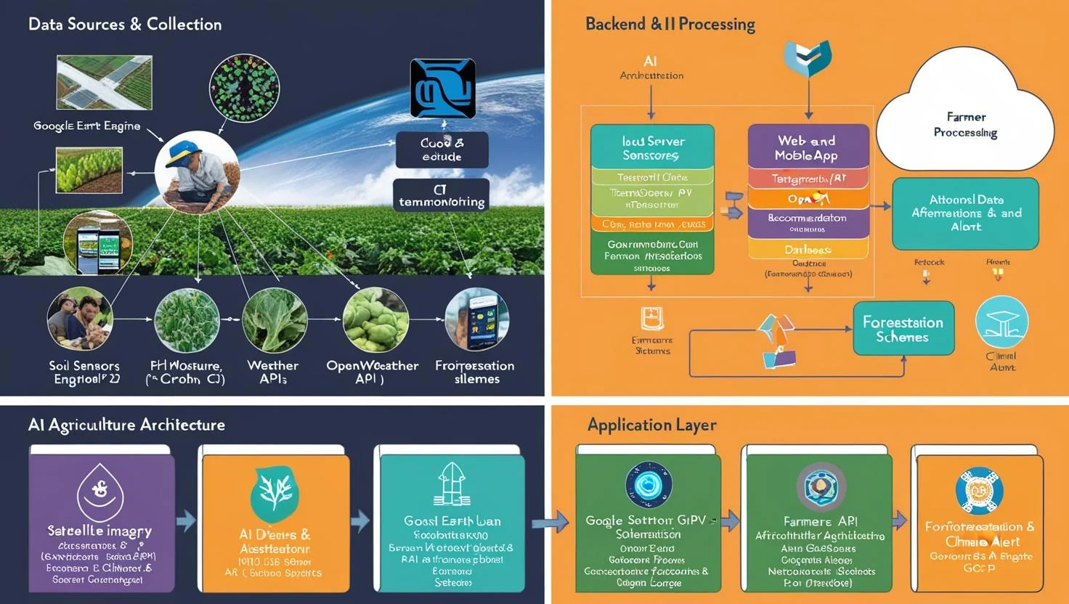
Architecture diagram of the proposed solution

Slide 10
Technologies to be used in the solution
1️⃣ Web & Mobile App Development
Frontend: React.js (for dynamic UI), Tailwind CSS (for styling).
Backend: Node.js with Express.js (for handling API requests).
Database: PostgreSQL / MongoDB (for storing farmer data, crop records).
Cloud Services: Firebase / AWS (for hosting and authentication).
2️⃣ AI & Machine Learning
Deep Learning: TensorFlow / PyTorch (for crop disease detection).
Computer Vision: OpenCV (for analyzing crop images).
Natural Language Processing (NLP): GPT-based AI chatbots (for farmer queries).
Predictive Analytics: Scikit-learn (for weather forecasting & crop yield predictions).
3️⃣ IoT & Data Collection
IoT Sensors: DHT11 (temperature, humidity), Soil pH sensors (nutrient monitoring).
Remote Sensing: Google Earth Engine / Sentinel-2 (for satellite imagery).
API Integration: OpenWeather API (for real-time weather updates).
4️⃣ Government & External Integrations
Loan Assistance API: For automated loan eligibility checks and applications.
Afforestation & Climate Alert System: To notify government agencies for tree plantations in global warming-affected areas.

Slide 11
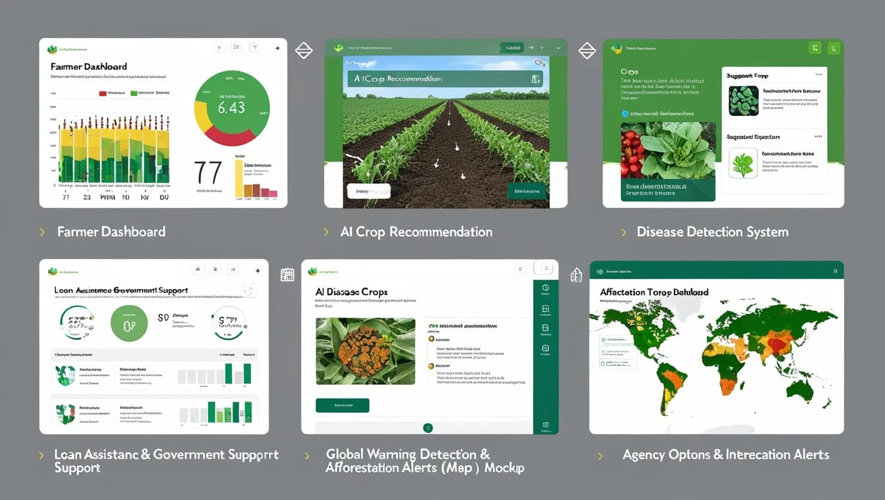
Snapshots of the MVP

Slide 12
Provide links to your:
GitHub Public Repository
Demo Video Link (3 Minutes)
MVP Link

Slide 13
